Slide 1
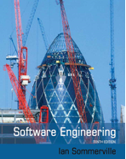
Software Engineering
Architectural Design
Assoc prof. dr. Tomas Blažauskas, 2018

Slide 2
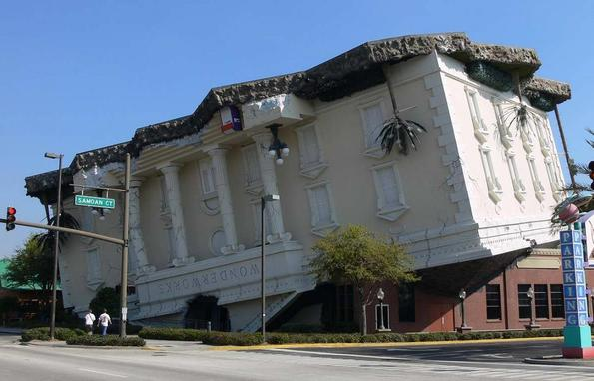
Architectural Design
Architectural styles and their combination
Notes:
https://www.youtube.com/watch?v=UZq4sZz56qM

Slide 3
Lecture topics
Introduction
Architectural design decisions
Architectural views
Architectural patterns

Slide 4
Architectural Design
Architectural design is concerned with understanding how a software system should be organized and designing the overall structure of that system.
Architectural design is the critical link between design and requirements engineering, as it identifies the main structural components in a system and the relationships between them.
The output of the architectural design process is an architectural model that describes how the system is organized as a set of communicating components.

Slide 5
Advantages of explicit architecture
Stakeholder communication
Architecture may be used as a focus of discussion by system stakeholders.
System analysis
Means that analysis of whether the system can meet its non-functional requirements is possible.
Large-scale reuse
The architecture may be reusable across a range of systems
Product-line architectures may be developed.

Slide 6
Architecture Design Processing
Analyze requirements - domain
Create business use - case
Select architecture pattern/style
Communicating architecture to stakeholders (prototypes)
Evaluate architecture
Implementation architecture - detail design

Slide 7
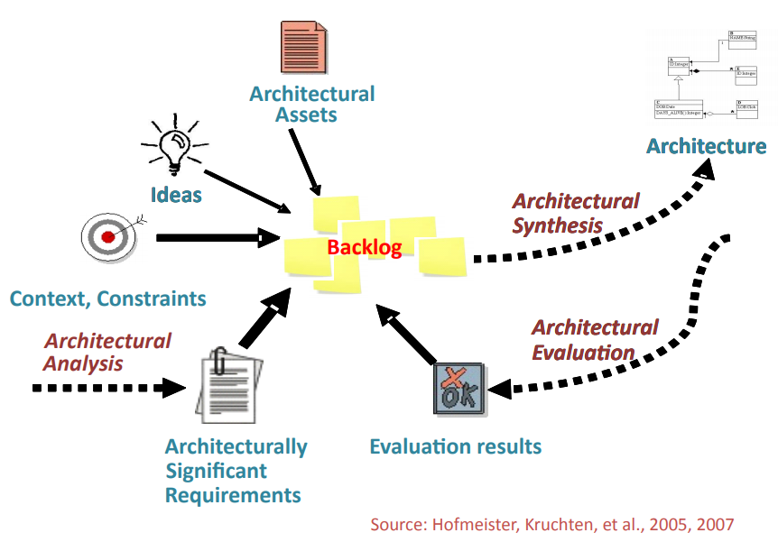
Agility and architecture
It is generally accepted that an early stage of agile processes is to design an overall systems architecture.
Refactoring the system architecture is usually expensive because it affects so many components in the system

Slide 8
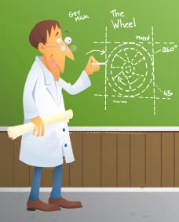
Architecture reuse
Systems in the same domain often have similar architectures that reflect domain concepts.
Application product lines are built around a core architecture with variants that satisfy particular customer requirements.
The architecture of a system may be designed around one of more architectural patterns or ‘styles’.
These capture the essence of an architecture and can be instantiated in different ways.

Slide 9
Architectural design decisions
Notes:
https://www.youtube.com/watch?v=laSrDtYtkXU&list=PLCku-ULHIQvlLC2gFqeoX-JtbEvmeoDhl&index=1

Slide 10
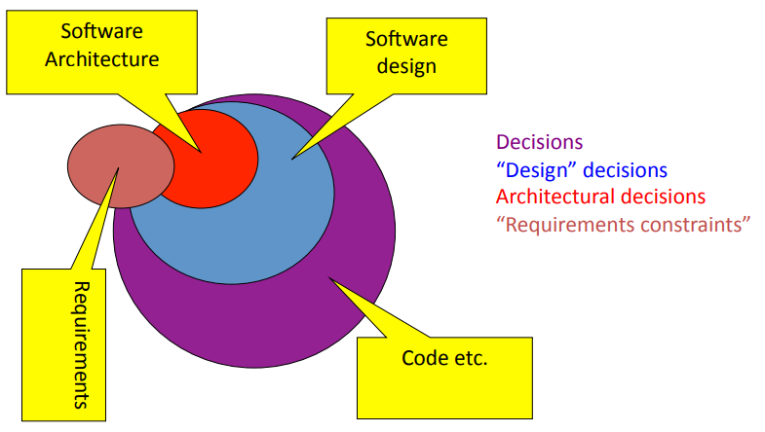
Architecture = Design Decisions
A choice that is binding in the final product

Slide 11
Architectural design decisions
Architectural design is a creative process so the process differs depending on the type of system being developed.
However, a number of common decisions span all design processes and these decisions affect the non-functional characteristics of the system.

Slide 12
Architectural design process
System structuring and partitioning
Decomposition of software system into sub-systems and communications between sub-systems
Sub-system is an independent system from other sub-systems.

Slide 13
Architectural design process
Controlling Models
Control relationships between different sub-systems
Data flow controlling
Control flow controlling
Decomposition of sub-system into components
Component (module) provides services to other component.
Reuse component

Slide 14
Architectural Attributes
Performance
Localize operations to minimize sub-system communication
Security
Use a layered architecture with critical assets in inner layers
Safety
Isolate safety-critical components
Availability
Include redundant components in the architecture
Maintainability
Use fine-grain, self-contained components

Slide 15
More Architectural Attributes
Testability
Modularity of the system (?)
Portability
Use architecture which allows creation of different parts in different languages/technologies, use data-driven approaches, use interpreter architecture style… (?)
Scalability
Use service oriented architecture, use micro-services (?)
…

Slide 16
Decisions based on Architectural Attributes
Trade off between attributes
Choose right architecture to reduce the risks
Impact of architecture on quality attributes
Trade off between space vs. time
Trade off between dependability and performance
Trade off between reliability and performance
Required quality attributes are identified in requirement process.

Slide 17
Other influential factors
Management - Schedule, budget, resource, …
Market - Feature, Time in market, …
Maintenance – Modifiability, …
Customer - Timing, Platform, …
End-user – Performance, Platform, …

Slide 18
Architecture design methods
Structured-oriented Design
Object-oriented Design
Component-oriented Design
Service-oriented Design
Aspect-oriented Design

Slide 19
Architectural views

Slide 20
Architectural views
What views or perspectives are useful when designing and documenting a system’s architecture?
What notations should be used for describing architectural models?
Each architectural model only shows one view or perspective of the system.
It might show how a system is decomposed into modules, how the run-time processes interact or the different ways in which system components are distributed across a network. For both design and documentation, you usually need to present multiple views of the software architecture.

Slide 21
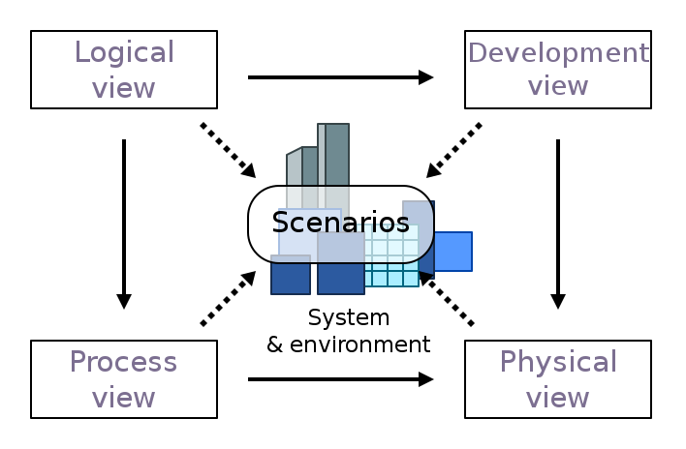
4+1 Architectural view model

Slide 22
4+1 Architectural view model
Development view: illustrates a system from a programmer's perspective and is concerned with software management. It uses the UML Component diagram as well as Package diagram to describe system components.
Logical view: concerned with the functionality that the system provides to end-users. It includes, class diagrams, and state diagrams.
Physical view: depicts the system from a system engineer's point of view. Deployment diagram usually is used to represent the physical view.
Process view: deals with the dynamic aspects of the system, explains the system processes and how they communicate, and focuses on the runtime behavior of the system. It includes the activity diagram.
Scenarios: a small set of use cases, or scenarios, which become a fifth view. The scenarios describe sequences of interactions between objects and between processes. This view is also known as the use case view.

Slide 23
Architectural styles/patterns

Slide 24
Architectural patterns
Patterns are a means of representing, sharing and reusing knowledge.
An architectural pattern is a stylized description of reusable design solution to commonly occurring problem, which has been tried and tested in different environments.
Architectural patterns are similar to software design patterns but have a broader scope.
Patterns should include information about when they are and when the are not useful.
Patterns may be represented using tabular and graphical descriptions.

Slide 25
Combining Architectural patterns
The architecture of a software system is almost never limited to a single architectural style, but is often a combination of architectural styles that make up the complete system.
For example, you might have a SOA design composed of services developed using a layered architecture approach and an object-oriented architecture style.
A combination of architecture styles is also useful if you are building a public facing Web application, where you can achieve effective separation of concerns by using the layered architecture style.
Most Engines (like Game Engines) use at least several architectural patterns.

Slide 26
List of common architectural patterns/styles
Pipes and filters
N-Layered / N-Tiered
Repository / Data Centered
Interpreter / Virtual Machine
Event-bus / Message-bus
Broker
Service Oriented Architecture (SOA)
Micro-services
Peer-to-peer
Client/Server
Component-based
MVC

Slide 27
The Layered architecture
Name | Layered architecture
Description | Organizes the system into layers with related functionality associated with each layer. A layer provides services to the layer above it so the lowest-level layers represent core services that are likely to be used throughout the system. See Figure in the next slide.
Example | Any application may consist of separate logical layers.
When used | Used when building new facilities on top of existing systems; when the development is spread across several teams with each team responsibility for a layer of functionality; when there is a requirement for multi-level security.
Advantages | Allows replacement of entire layers so long as the interface is maintained. Redundant facilities (e.g., authentication) can be provided in each layer to increase the dependability of the system.
Disadvantages | In practice, providing a clean separation between layers is often difficult and a high-level layer may have to interact directly with lower-level layers rather than through the layer immediately below it. Performance can be a problem because of multiple levels of interpretation of a service request as it is processed at each layer.

Slide 28
Layered architecture (an example)

Slide 29
Benefits of the layered architecture
Abstraction. Layers allow changes to be made at the abstract level. You can increase or decrease the level of abstraction you use in each layer of the hierarchical stack.
Isolation. Allows you to isolate technology upgrades to individual layers in order to reduce risk and minimize impact on the overall system.
Manageability. Separation of core concerns helps to identify dependencies, and organizes the code into more manageable sections.
Performance. Distributing the layers over multiple physical tiers can improve scalability, fault tolerance, and performance.
Reusability. Roles promote reusability. For example, in MVC, the Controller can often be reused with other compatible Views in order to provide a role specific or a user-customized view on to the same data and functionality.
Separation of concerns. It is a key component of building layered applications.
Testability. Increased testability arises from having well-defined layer interfaces, as well as the ability to switch between different implementations of the layer interfaces. Separated Presentation patterns allow you to build mock objects that mimic the behavior of concrete objects such as the Model, Controller, or View during testing.

Slide 30
The Tiered architecture
Name | Tiered architecture
Description | While the concepts of layer and tier are often used interchangeably, but there is a difference. Tier is a physical structuring mechanism for the system infrastructure. Organizes the system into physical layers. See Figure in the next slide.
Example | Many Web Applications.
When used | N-tier architectures are typically implemented as infrastructure-as-service (IaaS) applications, with each tier running on a separate set of VMs. However, an N-tier application doesn't need to be pure IaaS. Often, it's advantageous to use managed services for some parts of the architecture, particularly caching, messaging, and data storage.
Advantages | Allows high performance reliable applications (because of scalable tiers), portability.
Disadvantages | Monolithic design prevents independent deployment of features. It might be difficult to manage multi-tiered solutions.

Slide 31
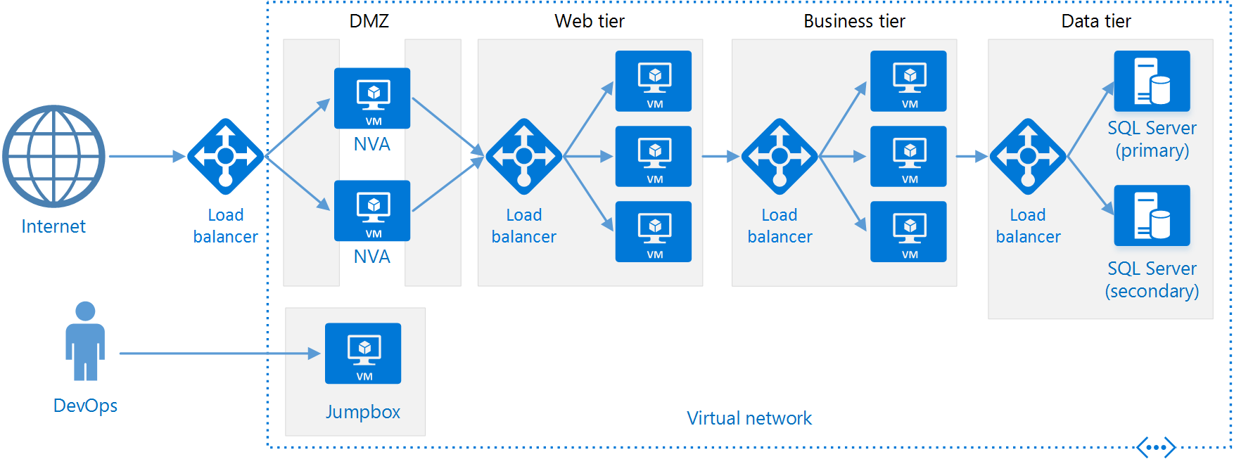
The Tiered architecture – an example

Slide 32
The Model-View-Controller (MVC)
Name | MVC (Model-View-Controller)
Description | Separates presentation and interaction from the system data. The system is structured into three logical components that interact with each other. The Model component manages the system data and associated operations on that data. The View component defines and manages how the data is presented to the user. The Controller component manages user interaction (e.g., key presses, mouse clicks, etc.) and passes these interactions to the View and the Model. See Figure in next slide.
Example | Figure in next slide shows the architecture of a web-based application system organized using the MVC pattern.
When used | Used when there are multiple ways to view and interact with data. Also used when the future requirements for interaction and presentation of data are unknown.
Advantages | Allows the data to change independently of its representation and vice versa. Supports presentation of the same data in different ways with changes made in one representation shown in all of them.
Disadvantages | Can involve additional code and code complexity when the data model and interactions are simple.

Slide 33
The organization of the MVC

Slide 34
Web Application using MVC

Slide 35
Repository / Data-driven / data-centeric
Sub-systems must exchange data. This may be done in two ways:
Shared data is held in a central database or repository and may be accessed by all sub-systems;
Each sub-system maintains its own database and passes data explicitly to other sub-systems.
When large amounts of data are to be shared, the repository model of sharing is most commonly used a this is an efficient data sharing mechanism.

Slide 36
Repository architecture
Name | Repository
Description | All data in a system is managed in a central repository that is accessible to all system components. Components do not interact directly, only through the repository.
Example | Figure in the next slide is an example of an IDE where the components use a repository of system design information. Each software tool generates information which is then available for use by other tools.
When used | You should use this pattern when you have a system in which large volumes of information are generated that has to be stored for a long time. You may also use it in data-driven systems where the inclusion of data in the repository triggers an action or tool.
Advantages | Components can be independent—they do not need to know of the existence of other components. Changes made by one component can be propagated to all components. All data can be managed consistently (e.g., backups done at the same time) as it is all in one place.
Disadvantages | The repository is a single point of failure so problems in the repository affect the whole system. May be inefficiencies in organizing all communication through the repository. Distributing the repository across several computers may be difficult.
Notes:
https://gamedevelopment.tutsplus.com/articles/what-is-data-oriented-game-engine-design--cms-21052

Slide 37
A repository architecture for an IDE

Slide 38

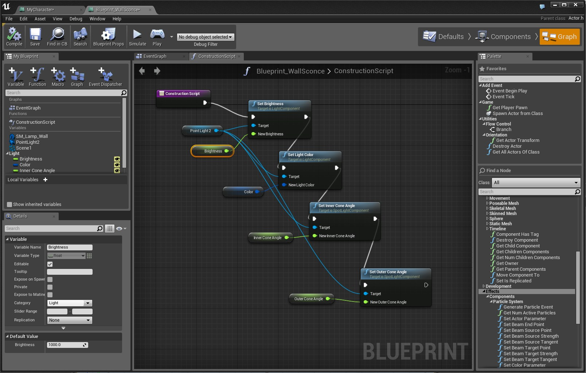
A repository architecture for Unreal Engine
Unreal Engine use several architectural patterns like Repository, Compiler and Interpreter patterns among others…

Slide 39
Interpreter / Virtual Machine
Name | Interpreter
Description | This pattern is used for designing a component that interprets programs written in a dedicated language. It mainly specifies how to evaluate lines of programs, known as sentences or expressions written in a particular language.
Example | Web browser, LUA
When used | This pattern is used in SQL parsing, symbol processing engine, game engines etc.
Advantages | Highly dynamic behavior is possible. Good for end user programmability. Enhances flexibility, because replacing an interpreted program is easy.
Disadvantages | Because an interpreted language is generally slower than a compiled one, performance may be an issue.

Slide 40
The Client–server pattern
Name | Client-server
Description | In a client–server architecture, the functionality of the system is organized into services, with each service delivered from a separate server. Clients are users of these services and access servers to make use of them.
Example | Lots of web based applications. Skype. Figure in the next slide is an example of a film and video/DVD library organized as a client–server system.
When used | Used when data in a shared database has to be accessed from a range of locations. Because servers can be replicated, may also be used when the load on a system is variable.
Advantages | The principal advantage of this model is that servers can be distributed across a network. General functionality (e.g., a printing service) can be available to all clients and does not need to be implemented by all services.
Disadvantages | Each service is a single point of failure so susceptible to denial of service attacks or server failure. Performance may be unpredictable because it depends on the network as well as the system. May be management problems if servers are owned by different organizations.

Slide 41
The Client–server

Slide 42
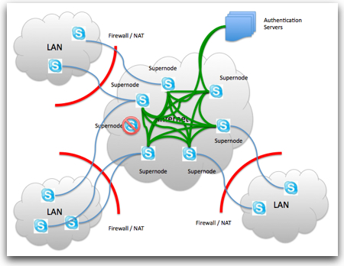
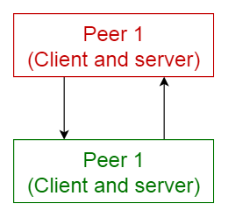
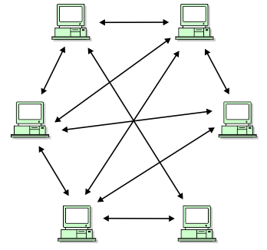
Peer-to-Peer Architecture
In this pattern, individual components are known as peers. Peers may function both as a client, requesting services from other peers, and as a server, providing services to other peers. A peer may act as a client or as a server or as both, and it can change its role dynamically with time.

Slide 43
Peer-to-peer
Name | Peer-to-peer
Description | In this pattern, individual components are known as peers. Peers may function both as a client, requesting services from other peers, and as a server, providing services to other peers. A peer may act as a client or as a server or as both, and it can change its role dynamically with time.
Example | Bittorent, Gnutella, P2PTV, PDRP, Spotify, Skype (until 2018)
When used | Multiple systems need to share common information and applications along with the resource demands. A peer-to-peer network is a distributed application architecture that partitions tasks or work loads between peers.
Advantages | Applications with high resource (networking) demands. If developed properly applications with high security and privacy.
Disadvantages | This pattern is not applicable if the application or the information cannot be distributed on multiple servers. The scalability of the applications and information access needs to be examined and managed, since this may be an issue if growth is expected, especially the numbers of peers that communicate simultaneously. If not developed properly, IT security becomes and important aspect of the solution.

Slide 44
Pipes and Filters Architecture
Functional transformations process their inputs to produce outputs.
May be referred to as a pipe and filter model (as in UNIX shell).
Variants of this approach are very common. When transformations are sequential, this is a batch sequential model which is extensively used in data processing systems.
Not really suitable for interactive systems.

Slide 45
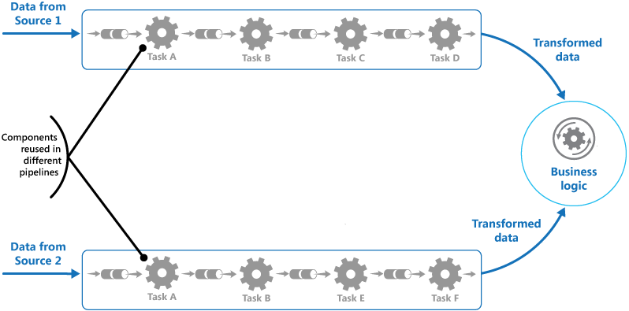
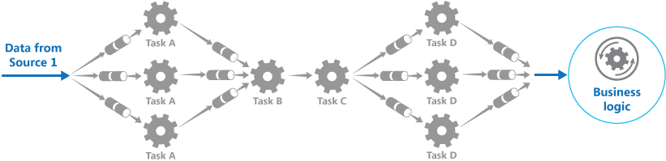
Pipes and filters architecture

Slide 46
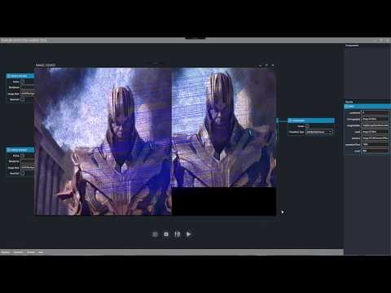
Pipes and filters architecture

Slide 47
The pipes and filters pattern
Name | Pipes and filters
Description | The processing of the data in a system is organized so that each processing component (filter) is discrete and carries out one type of data transformation. The data flows (as in a pipe) from one component to another for processing.
Example | Production of video by running video producing and encoding tasks.
When used | Commonly used in data processing applications (both batch- and transaction-based) where inputs are processed in separate stages to generate related outputs.
Advantages | Easy to understand and supports transformation reuse. Workflow style matches the structure of many business processes. Evolution by adding transformations is straightforward. Can be implemented as either a sequential or concurrent system.
Disadvantages | The format for data transfer has to be agreed upon between communicating transformations. Each transformation must parse its input and unparse its output to the agreed form. This increases system overhead and may mean that it is impossible to reuse functional transformations that use incompatible data structures.

Slide 48
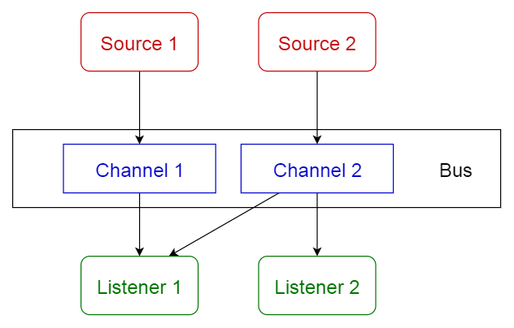
Event-bus / Message-bus architecture

Slide 49
Event / Message-bus
Name | Event / Message bus
Description | This pattern primarily deals with events and has 4 major components; event source, event listener, channel and event bus. Sources publish messages to particular channels on an event bus. Listeners subscribe to particular channels. Listeners are notified of messages that are published to a channel to which they have subscribed before.
Example | Android development. Notification services.
When used | When you need to decouple components to achieve effective distribution.
Advantages | New publishers, subscribers and connections can be added easily. Effective for highly distributed applications.
Disadvantages | Scalability may be a problem if all messages travel through the same bus.

Slide 50
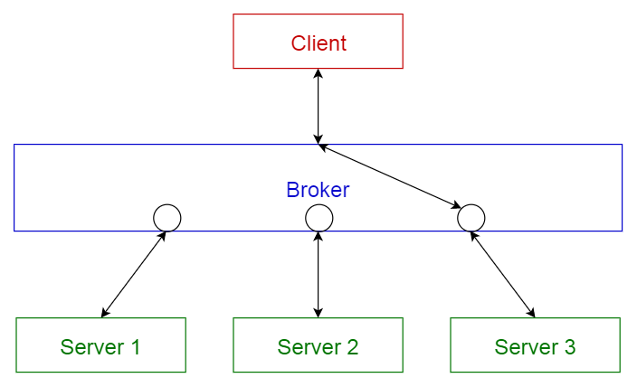
Broker

Slide 51
Broker
Name | Broker
Description | It is the case when the components can interact with each other by remote service invocations. A broker component is responsible for the coordination of communication among components. Servers publish their capabilities (services and characteristics) to a broker. Clients request a service from the broker, and the broker then redirects the client to a suitable service from its registry.
Example | Message broker software such as Apache ActiveMQ, Apache Kafka, RabbitMQ and JBoss Messaging.
When used | This pattern is used to structure distributed systems with decoupled components.
Advantages | Allows dynamic change, addition, deletion and relocation of objects, and it makes distribution transparent to the developer
Disadvantages | Requires standartization of service descriptions.

Slide 52
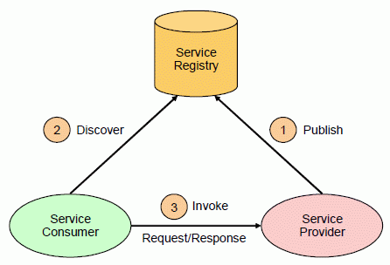
Service Oriented Architecture
Service-oriented architecture (SOA) enables application functionality to be provided as a set of services, and the creation of applications that make use of software services. Services are loosely coupled because they use standards-based interfaces that can be invoked, published, and discovered. Services in SOA are focused on providing a schema and message-based interaction with an application through interfaces that are application scoped, and not component or object-based.

Slide 53
Key principles of SOA
Services are autonomous. Each service is maintained, developed, deployed, and versioned independently.
Services are distributable. Services can be located anywhere on a network, locally or remotely, as long as the network supports the required communication protocols.
Services are loosely coupled. Each service is independent of others, and can be replaced or updated without breaking applications that use it as long as the interface is still compatible.
Services share schema and contract, not class. Services share contracts and schemas when they communicate, not internal classes.
Compatibility is based on policy. Policy in this case means definition of features such as transport, protocol, and security.

Slide 54
Main benefits of SOA
Domain alignment. Reuse of common services with standard interfaces increases business and technology opportunities and reduces cost.
Abstraction. Services are autonomous and accessed through a formal contract, which provides loose coupling and abstraction.
Discoverability. Services can expose descriptions that allow other applications and services to locate them and automatically determine the interface.
Interoperability. Because the protocols and data formats are based on industry standards, the provider and consumer of the service can be built and deployed on different platforms.
Rationalization. Services can be granular in order to provide specific functionality, rather than duplicating the functionality in number of applications, which removes duplication.

Slide 55
Service Oriented Architecture
Name | SOA
Description | It is the case when the components can interact with each other by remote service invocations. A broker component is responsible for the coordination of communication among components. Servers publish their capabilities (services and characteristics) to a broker. Clients request a service from the broker, and the broker then redirects the client to a suitable service from its registry.
Example | The whole world of API’s (Twitter, Google, Facebook, etc…)
When used | Consider the SOA style if you have access to suitable services that you wish to reuse; can purchase suitable services provided by a hosting company; want to build applications that compose a variety of services into a single UI; or you are creating Software plus Services (S+S), Software as a Service (SaaS), or cloud-based applications.
Advantages | Domain alignment, Abstraction, Discoverability, Interoperability, Rationalization.
Disadvantages | Not appropriate for real-time applications, stand-alone and homogenous applications, applications with high-frequency client-server communication

Slide 56
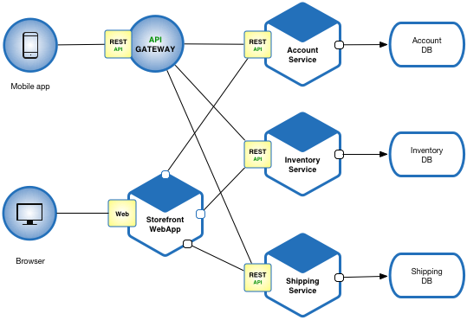
Micro-services Architecture
An architecture that structures the application as a set of loosely coupled, collaborating services. Each service implements a set of narrowly, related functions. Services communicate using either synchronous protocols such as HTTP/REST. Services can be developed and deployed independently of one another. Each service has its own database in order to be decoupled from other services.

Slide 57
Micro-services pattern
Name | Micro-services
Description | An architecture that structures the application as a set of loosely coupled, collaborating services. Each service implements a set of narrowly, related functions. Services communicate using either synchronous protocols such as HTTP/REST. Services can be developed and deployed independently of one another. Each service has its own database in order to be decoupled from other services.
Example | http://eventuate.io/exampleapps.html
When used | The same as SOA. When you want to enjoy all the benefits of small applications (integrating new team members, practice continuous deployment, take advantage of emerging technologies, etc…)
Advantages | Enables the continuous delivery and deployment of large, complex applications. Improved fault isolation. Eliminates any long-term commitment to a technology stack.
Disadvantages | Developers must deal with the additional complexity of creating a distributed system. Deployment complexity. Increased memory consumption (N small applications instead of 1 big one).

Slide 58
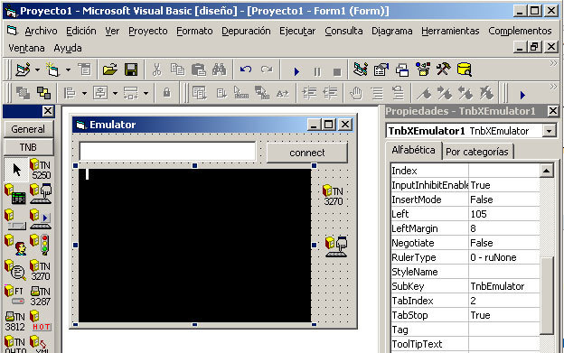
Component-based architecture
It focuses on the decomposition of the design into individual functional or logical components that expose well-defined communication interfaces containing methods, events, and properties. This provides a higher level of abstraction than object-oriented design principles, and does not focus on issues such as communication protocols and shared state.

Slide 59
Key principles of CBA
Reusable. Components are usually designed to be reused in different scenarios in different applications. However, some components may be designed for a specific task.
Replaceable. Components may be readily substituted with other similar components.
Not context specific. Components are designed to operate in different environments and contexts. Specific information, such as state data, should be passed to the component instead of being included in or accessed by the component.
Extensible. A component can be extended from existing components to provide new behavior.
Encapsulated. Components expose interfaces that allow the caller to use its functionality, and do not reveal details of the internal processes or any internal variables or state.
Independent. Components are designed to have minimal dependencies on other components. Therefore components can be deployed into any appropriate environment without affecting other components or systems.

Slide 60
Main benefits of CBA
Ease of deployment. As new compatible versions become available, you can replace existing versions with no impact on the other components or the system as a whole.
Reduced cost. The use of third-party components allows you to spread the cost of development and maintenance.
Ease of development. Components implement well-known interfaces to provide defined functionality, allowing development without impacting other parts of the system.
Reusable. The use of reusable components means that they can be used to spread the development and maintenance cost across several applications or systems.
Mitigation of technical complexity. Components mitigate complexity through the use of a component container and its services. Example component services include component activation, lifetime management, method queuing, eventing, and transactions.

Slide 61
Component-based architecture
Name | Component-based
Description | It focuses on the decomposition of the design into individual functional or logical components that expose well-defined communication interfaces containing methods, events, and properties. This provides a higher level of abstraction than object-oriented design principles, and does not focus on issues such as communication protocols and shared state.
Example | Delphi IDE is based on component-based architecture. Various engines, frameworks supporting assets, plugins, components.
When used | When reusability of the software parts is one of the main aspects.
Advantages | Reusability, Ease of deployment, Reduced cost, Ease of development, mitigation of technical complexity.
Disadvantages | Time and effort required for development of components, Unclear and ambiguous requirement, Component maintenance costs, Reliability and sensitivity to changes.

Slide 62
Key points

Slide 63
Key points
A software architecture is a description of how a software system is organized.
Architectural design decisions include decisions on the type of application, the distribution of the system, the architectural styles to be used.
Architectures may be documented from several different perspectives or views such as a conceptual view, a logical view, a process view, and a development view.
Architectural patterns are a means of reusing knowledge about generic system architectures. They describe the architecture, explain when it may be used and describe its advantages and disadvantages.

